Slide 1



Data Science Capstone
Stock prediction using Machine learning and integration with sentimental analysis
By,
Nihar Muniraju[2072857] Sushma Nagula[2154263]

Slide 2


INTRODUCTION
We have analysed a dataset spanning from January 2, 2019, to December 29, 2023, encompassing stock tickers such as Apple, Google, Microsoft, Intel, and Nvidia.
Our approach involved developing classifiers to predict the directional movement of these stock tickers—whether they will go up or down. Additionally, we implemented regression models to forecast the 1-day and 7day future percentage change in stock price.
We have made use of random forest model to check how the model preforms on all the tickers.
And then we utilized more than five different models in our analysis and subsequently integrated them into an ensemble model using a voting regressor for enhanced accuracy.
To complement our quantitative analysis, we also incorporated sentiment analysis to evaluate its impact on the percentage change of the stock prices.

Slide 3
Data Fetching, Exploration, Feature Engineering, Preprocessing
We utilized Yahoo Finance to download historical Adj_Close of stock data for Apple, Google, Microsoft, Intel, and Nvidia.
We have used 18 indicators which include Simple Moving Average (SMA), Exponential Moving Average (EMA), Moving Average Convergence Divergence (MACD), Relative Strength Index (RSI), Commodity Channel Index (CCI), and others to capture the trend.
For Data preprocessing we handled all missing values, normalized features using standard scaler, removed highly correlated features, apply PCA for dimensionality reduction.
For sentiment analysis, we utilized the FNSPID dataset introduced in the paper "FNSPID: A Comprehensive Financial News Dataset in Time Series". This dataset spans from 1999 to 2023 and integrates stock prices with financial news for 4,775 S&P500 companies. It provides a large-scale resource that combines quantitative and qualitative sentiment analyses, facilitating advanced research in financial modelling, sentiment analysis, and time-series prediction.

Slide 4
METHODLOGY
Stock Prediction:
We have trained our data on 5 types of different model classifiers such as random forest, svc, decision tree, xgboost, catboost and performed hyperparameters using grid search and then sent all the models to an ensemble model to check how better they can perform on the precision and recall of the classification report.
Then simultaneously we have performed the regression style percentage prediction on models such as gradient boosting, ridge, laso, random forest, svr, decision tree, xgboost, adaboost, catboost with hyperparameter tuning and then send data to the ensemble method to check the voting of a good ensemble method.
Sentimental analysis:
For sentimental analysis, We used the transformers library from Hugging Face to initialize a pre-trained BERT model specifically fine-tuned for sentiment analysis.
Given the large volume of news articles, we split the data into manageable batches and utilized multiprocessing to speed up the sentiment analysis process.
The sentiment scores were averaged on daily basis for each stock symbol to create a daily sentiment score. This step ensured that we captured the overall sentiment trend for each stock on any given day.

Slide 5
METHODLOGY
Defined model selection Stock Prediction:
We selected models based on stock price ranges: For prices below $100, we used RandomForestRegressor.
For prices between $100 and $200, we used GradientBoostingRegressor.
For prices between $200 and $500, we used Ridge.
For prices between $500 and $1000, we used XGBRegressor.
For prices above $1000, we used Lasso.
Hyperparemeter tuning :
For RandomForest, we tuned the following hyperparameters:n_estimators:[100,200]
max_depth: [5, 10]
min_samples_split: [2, 5]
min_samples_leaf: [1, 2]
We used GridSearchCV from the sklearn library for hyperparameter tuning.

Slide 6

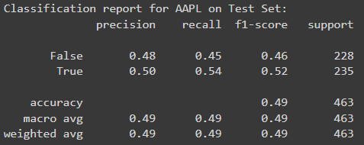
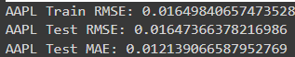

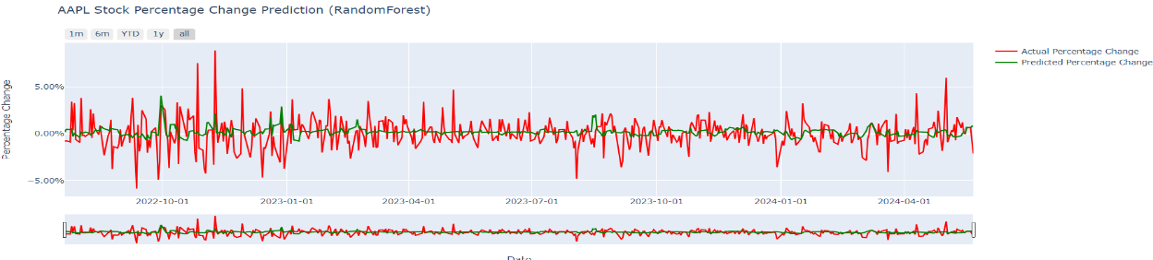
Results
Stock Prediction:
1 day percentage change using Random forest

Slide 7
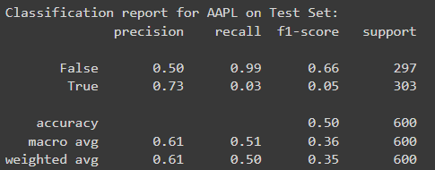
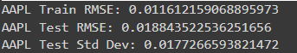
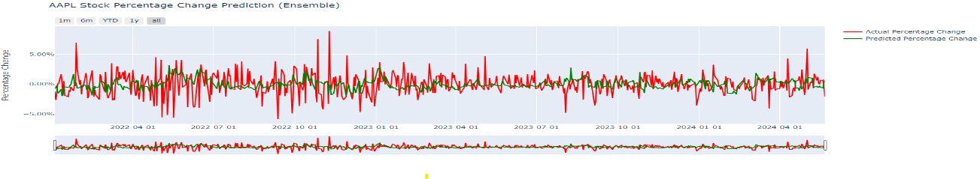
Results
Stock Prediction:
We are checking best performing model for each stock with minimum and maximum RMSE of the different regression models and we are performing cross validation scores to prevent the models from overfitting
1 day percentage change for ensemble modelling with hyperparameters

Slide 8
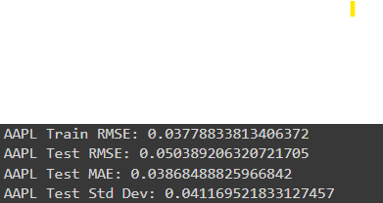
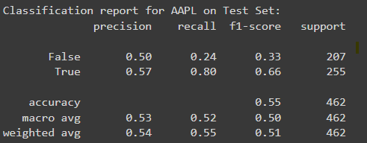
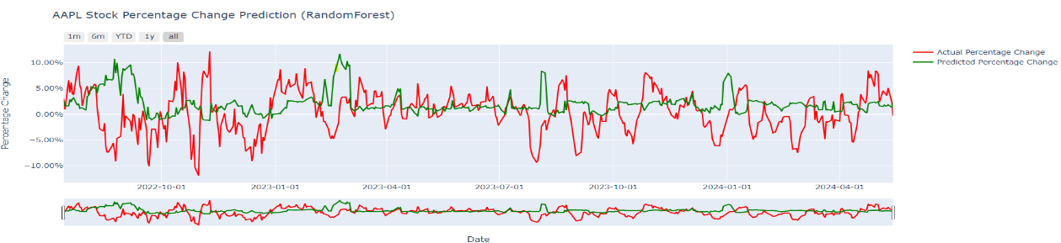
Results
Stock Prediction:
7-day percentage change using Random forest

Slide 9
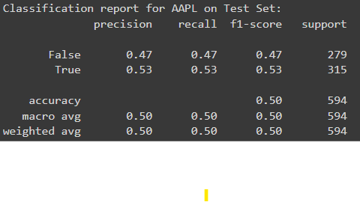
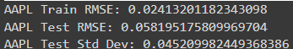
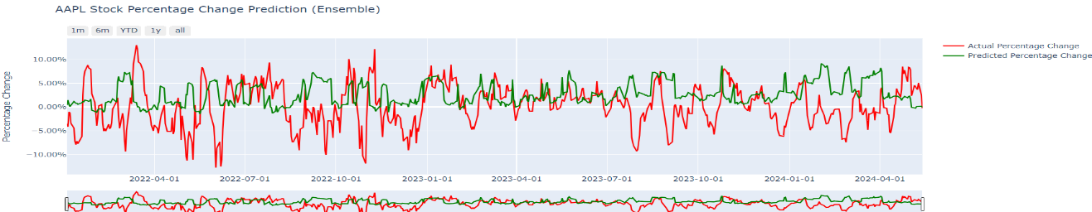
Results
Stock Prediction:
7-day percentage change for ensemble modelling with hyperparameters

Slide 10
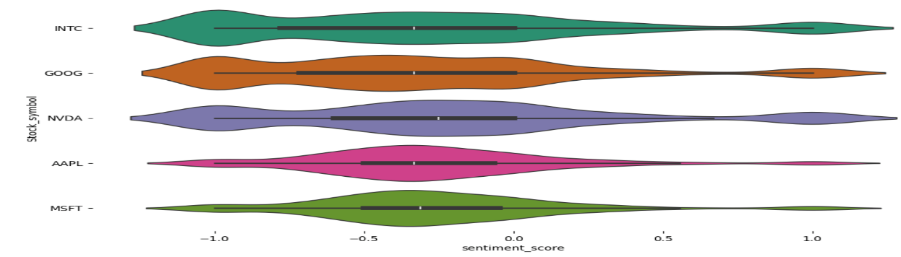
Results
Sentimental analysis
The polarity score for the headlines has been retrieved ranging between -1 and 1.
From the plot , we can see most of the headlines in the dataset are categorized as Negative and Neutral and we have very few headlines labelled as Positive.

Slide 11
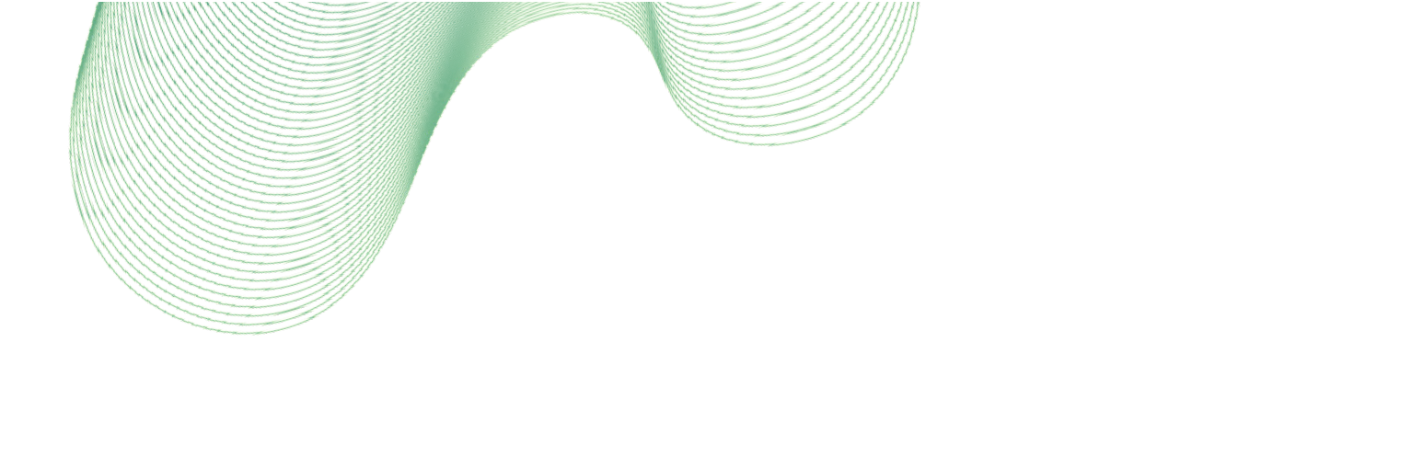

Conclusion
In summary, we applied multiple regression models to predict stock price changes, using technical indicators for feature engineering.
We implemented hyperparameter tuning for Random Forest and evaluated models using RMSE and MAE.
We used ensemble methods and checked which models were performing better with minimum and maximum rmse and checked if ensemble method did better than random forest.
Our comprehensive analysis of NASDAQ stock sentiment from 2019 to 2023 reveals that while sentiment scores provide some insights into market perception, their direct impact on stock prices is limited.
The weak correlations and low predictive power of sentiment scores in our linear regression model suggest that stock price movements are influenced by a multitude of factors beyond news sentiment alone.
This underscores the importance of incorporating a broader set of variables and considering other market dynamics for more accurate stock price prediction and investment strategies.
Further research in this area could explore the integration of alternative data sources and more sophisticated modeling techniques to better capture the complex interplay between market sentiment and stock performance.
Future work includes exploring other machine learning techniques, incorporating more features, and extending the analysis to more stocks and perform sentimental analysis for predicting stocks.

